Slide 1
Larissa Fekete, ESOL Program Director & Senior Instructor
LFekete@Oberlin.edu
Kathy Abromeit, Head Oberlin Conservatory Library
KAbromei@Oberlin.edu

Slide 2
Overview of Presentation
Students and AI
Oberlin’s AI Policy
Collaborating with the Library
Designing Learning Outcomes
Pre-Lesson Skills Development
Interactive Lesson Demonstration
AI Example
Student Findings
Insights and Takeaways
Discussion and Q&A

Slide 3
Students and AI Usage
International Students with Intermediate English Proficiency
Majority Music Majors
Using AI all the time, but using it incorrectly
Thinking is sounds better than anything they can write
Need to create AI-proof prompts
Create awareness of the limitations of AI

Slide 4
Oberlin’s Policy on AI
On May 17, 2023, Oberlin changed the school’s Honor Code Charter to include the use of artificial intelligence as a punishable offense under the cheating section of the Code. The Honor Code Charter is reviewed by the Honor Committee every three years.
The amended Charter prohibits using “artificial intelligence software or other related programs to create or assist with assignments on the behalf of a student unless otherwise specified by the faculty member and/or the Office of Disability & Access.”
Some faculty members have begun creatively adding ChatGPT to their curriculums to allow students to understand its capabilities and limitations.

Slide 5
ESOL and Library Collaboration
Motivating lesson
Modified Version of McGill University Lesson
Engage Library Resources - 5 of them
OBIS, Grove, Composer/Publisher Website, Citation Guide
Appeal to international perspective
Five international women composers
Unsuk Chin "Subito con forzo”
Tania León “Homenatge”
Chen Yi “Chinese Myths Cantata”
Libby Larsen “Song without Words”
Shulamit Ran “moon songs”

Slide 6
Learning Outcomes
ESOL
Research and Information Literacy:
Students will learn to conduct basic searches in OBIS and Grove Music Online, and applying CMOS for citations.
Students will evaluate AI-generated content, assess its accuracy, and recognize the limitations of AI in research.
Fact-Checking and Evaluation:
Students will explain the importance of fact-checking, distinguishing between factual and subjective information
Students will use complex prompting with AI tools to generate content
Students will apply the new research skills to verify AI-generated content and compile CMOS citations and bibliographies
ACRL Framework
Students will be able to critically evaluate the AI generated content with the help of music research tools.
Comprehend that AI generated content will require vigorous evaluation,fact checking, and verification.
Note: These are a condensed version of the learning outcomes, the full outcomes are available upon request

Slide 7
ACRL Framework
The Association of College and Research Libraries (ACRL) Framework for Information Literacy for Higher Education is a set of concepts and practices that help librarians, faculty, and other institutional partners improve information literacy instruction:
Concepts
The framework is organized into six frames, each centered around a concept related to information literacy:
Authority is Constructed and Contextual
Information Creation as a Process
Information Has Value
Research as Inquiry
Scholarship as Conversation
Searching as Strategic Exploration

Slide 9
Pre-Lesson Skill Development
Grove Dictionary of Music and sample searches
OBIS (Oberlin’s online library catalog)
Fact checking using Grove and OBIS
Explain Fact Checking:
Give 3 things they can fact check in Grove
Beethoven wrote 15 symphonies
Brahms was a Russian Composer
Oberlin Conservatory of Music was established in 1833.
Practice searching in OBIS for a CD and score for a piece of their choice.

Slide 10
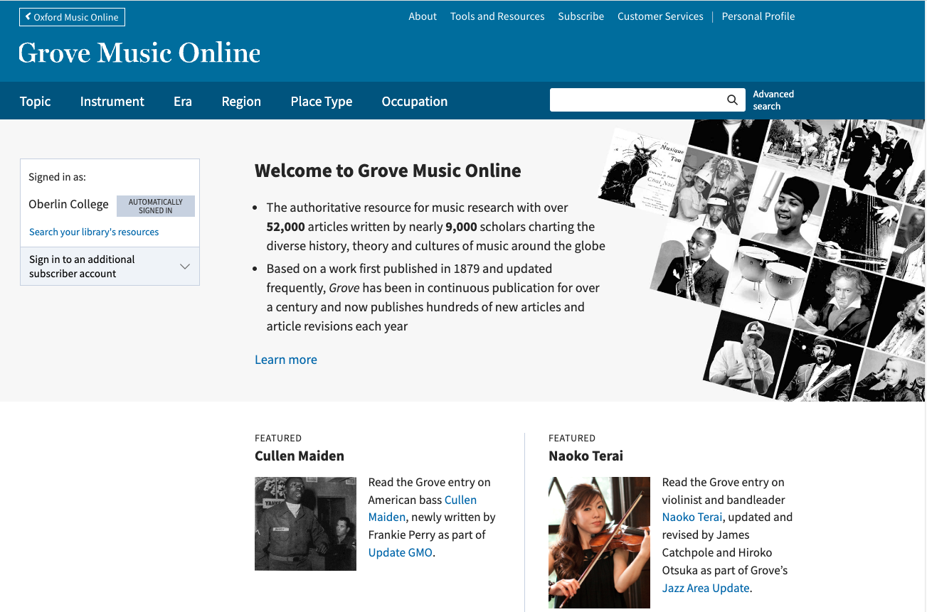

Slide 11
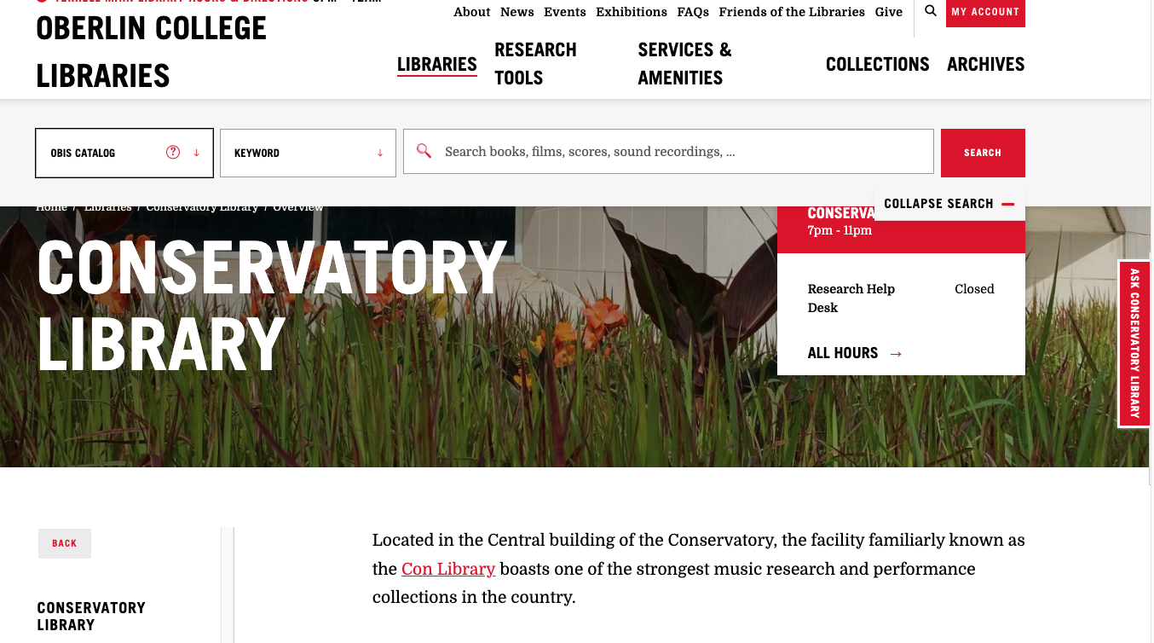

Slide 12
Interactive Lesson
For this assignment, using ChatGPT you will:
Prompt: Generate a concert program note on the [identify musical work]. Include biographical information about the composer, the work itself, the characteristic or compositional style of the work, the date of composition, when and where it was premiered, and the audience's general response. Include also information about a recording of a major or the first performance of this work. Limit the program note to 300 words. Provide a bibliography of all sources used in Chicago citation style.
You will then fact-check the AI-generated content and its sources using the fact-checking tools provided in this guide. Provide appropriate in-text citations for each fact checked.
You will cite the AI-generated content and each source used for fact-checking in your bibliography using Chicago style.

Slide 13
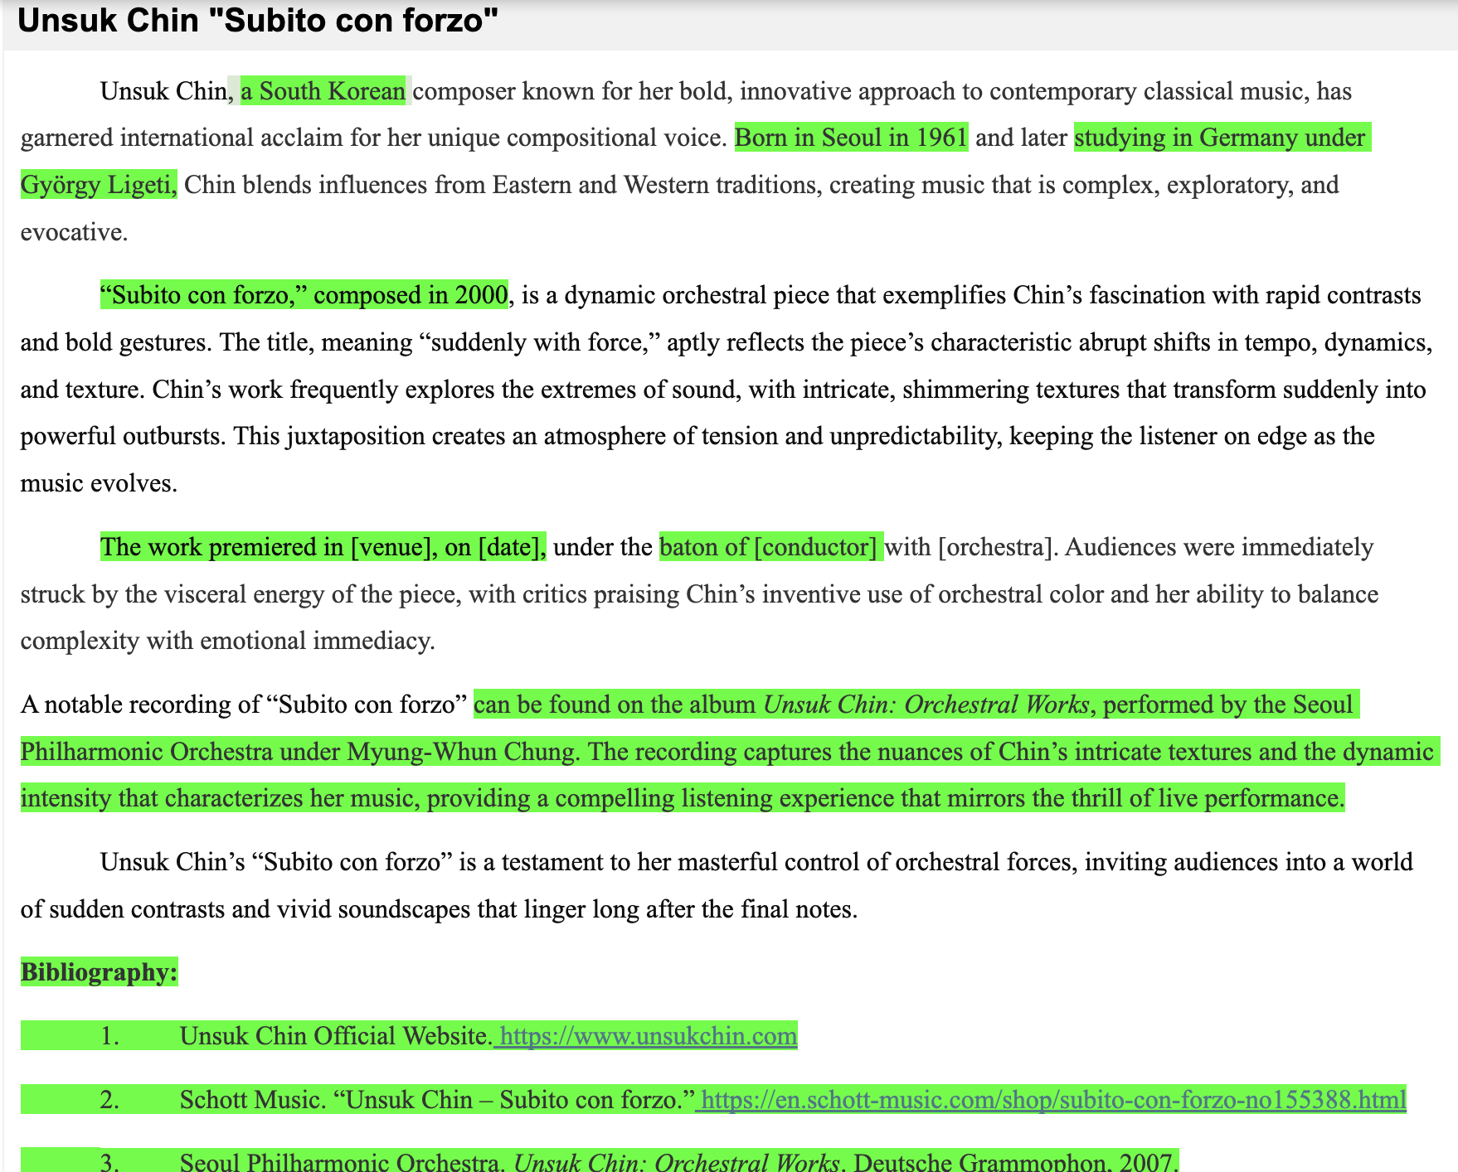
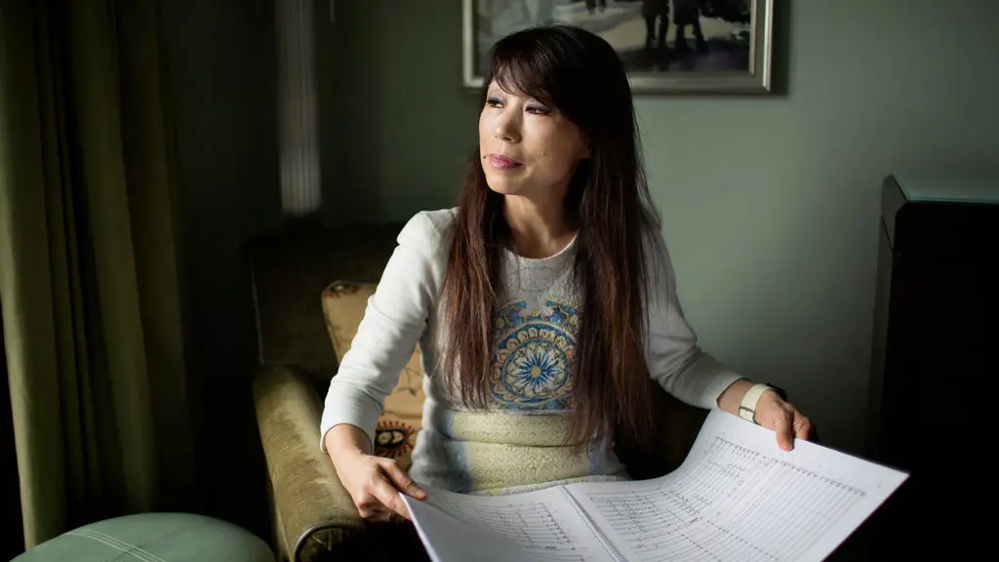
AI Example
Unsuk Chin "Subito con forzo”

Slide 14
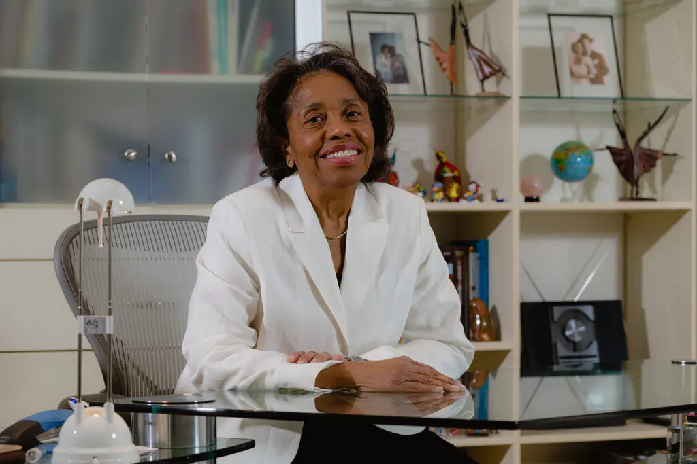
Student Findings
ChatGPT: She earned a degree
from the University of Miami
Fact- Checking: She graduate of the Peyrellade’s Conservatorio
de Música in Havana (BA 1963,
MA 1964)
Verified: Grove Music Online.
Tania León
“Homenatge”

Slide 15
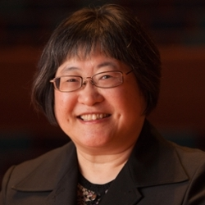
Student Findings
ChatGPT: Written in 1996
Fact- Checking: Correct
Verified: Grove Music Online.
Chen Yi
“Chinese Myths Cantata”

Slide 16
Student Findings
ChatGPT: The premiere took place on April 10, 1995, at the Schubert Club in St. Paul, performed by the pianist Lydia Artymiw
Fact- Checking: August 3, 1986, St. John's Lutheran Church, Minneapolis, Minnesota, Marlene Pauley, clarinet, Edward Turley, piano
Verified: Composer Website
Libby Larsen
“Song without Words”

Slide 17
Student Findings
ChatGPT: The world premiere took place on April 17, 1982, at the University of Chicago, performed by soprano Phyllis Bryn-Julson and pianist John Harbison
Fact- Checking: Her Moon Songs, commissioned and premiered in 2012 by the Dolce Suono Ensemble
Verified: Composer Website at Presser.com
Shulamit Ran
“moon songs”

Slide 18
Student Insights and Takeaways
AI
“It is also possible for AI to make mistakes”
“I know that AI sometime may have some mistake “
“AI has too much wrong ，and the content is inaccurate”
“AI It's not all right”
9/14 students reported similarly about AI’s inaccuracies.
Fact-Checking
“After doing the fact- checking, the essay would be with higher authority.”
“Ai don't give perfect answers so its important to check it“
“precise and usefull”
“Ai don't give perfect answers so its important to check it“
“search information from library”

Slide 19
Insights and Takeaways
Be prepared for questions and challenges.
Students loved this task and were very engaged
Reflected on how using AI made more work for them
Searching with natural language vs keyword vs Library of Congress Subject Headings
Students realized the importance of using librarians for research support

Slide 20
Discussion and Q&A
Collaboration
Lesson Design
AI and Prompt Design
Student Outcomes

